Slide 1

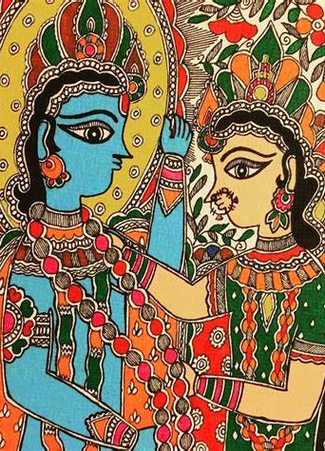
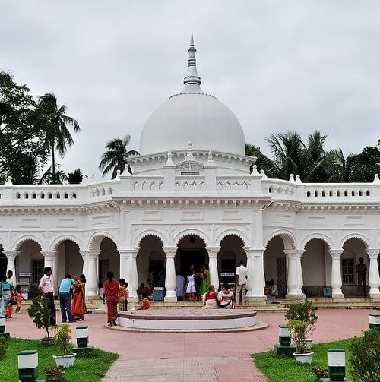
Cultural Canvas Explore the hidden gems of West Bengal

Slide 2
Table of contents
01
02
03
04
05
06
Goals and objectives
Some of the goals fulfilled
Places
Food
Arts
Query Bot

Slide 3
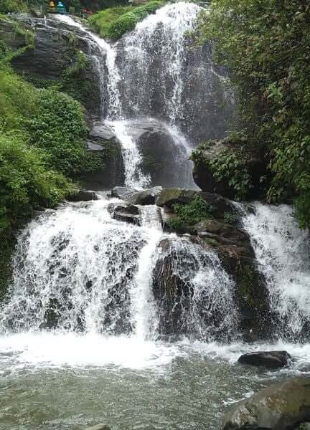
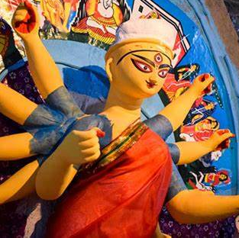
01
Goals and objectives

Slide 4


Goals and objectives
Problem Statement
Solution
Bengal's rich cultural tapestry presents challenges for tourists. Local artisans and businesses struggle to share their talents. This complexity hinders travelers in discovering attractions, cuisines, and cultural nuances, while impacting artists' livelihoods.
Introducing Cultural Canvas – a platform dedicated to promoting the local artists, food, culture, and tourism in West Bengal, India. We believe in not just showcasing the beauty of Bengal, but also to work for the welfare of people, both locally and globally.

Slide 5
Some of the goals fulfilled
More reach
Engagement
Conversions
Places are gaining more recognition which would not be possible if they were not located in prime spots.
People are becoming more aware of the rich heritage they offer.
Improving engagement for the local artisans who can showcase their talent all over the world and gain public reputation and customers through our website.
Local business owners whose income is directly or indirectly dependent on the number of the tourists visiting a place, will gain a rise in sales volume.

Slide 6
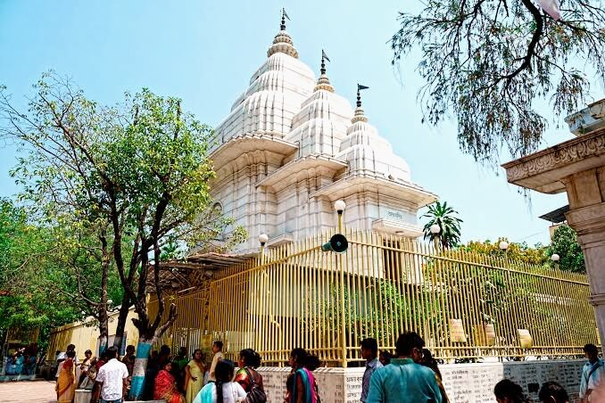
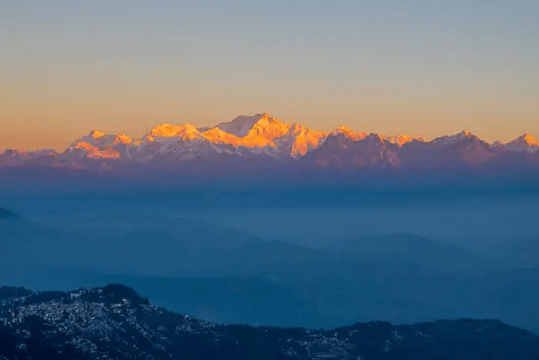
Places
Experience the breathtaking scenaries, historical buildings and much more.

Slide 7
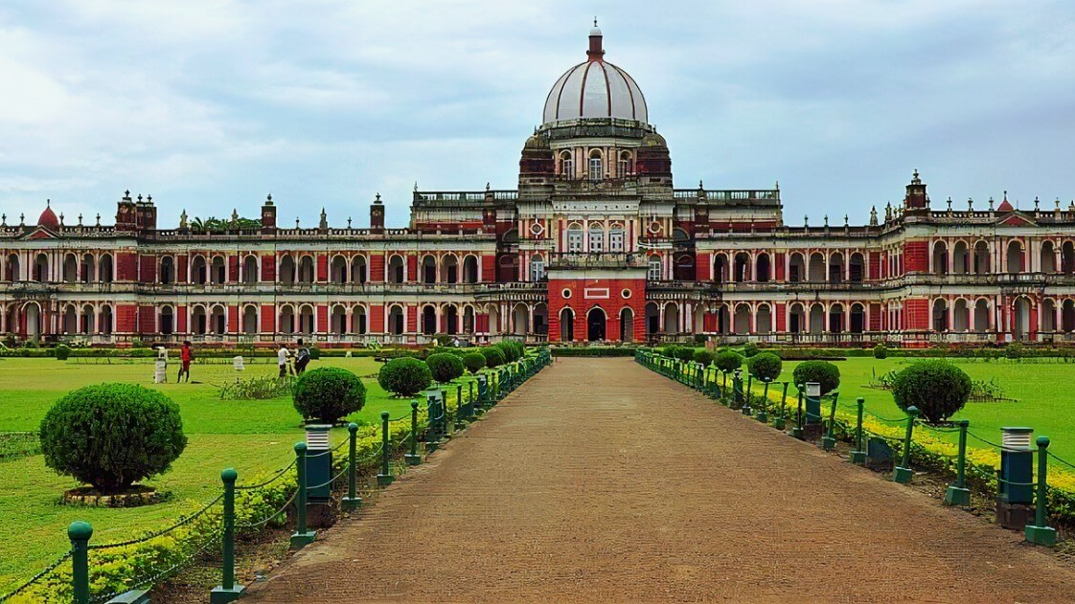
We strive to bring out all the hidden gems to the world

Slide 8
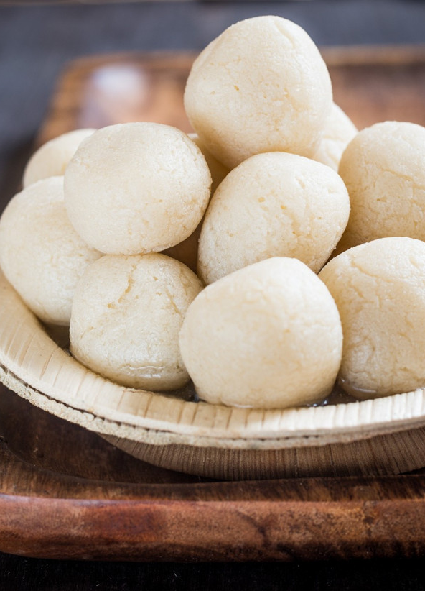
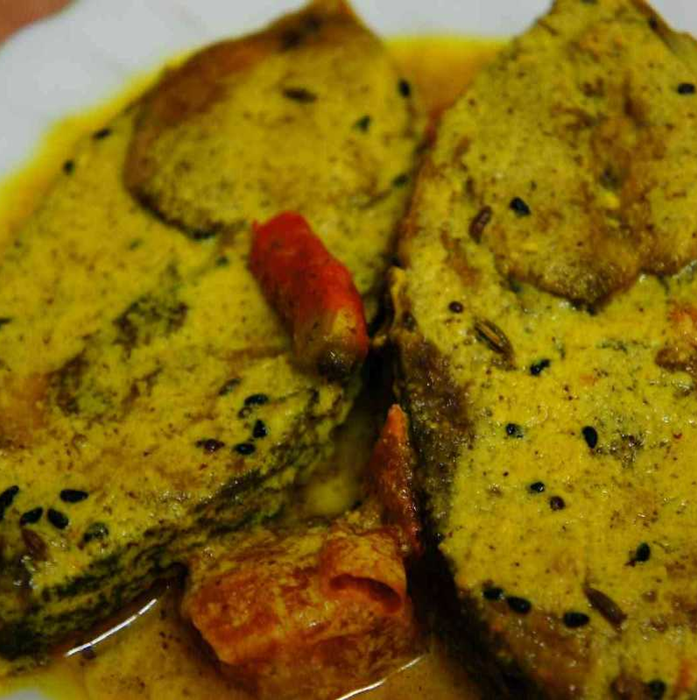
Food
Experience the rich delicacies of Bengal

Slide 9
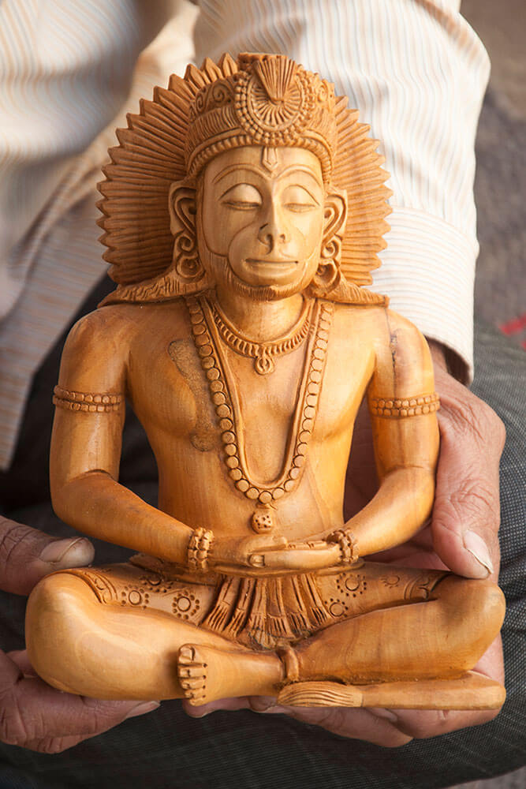
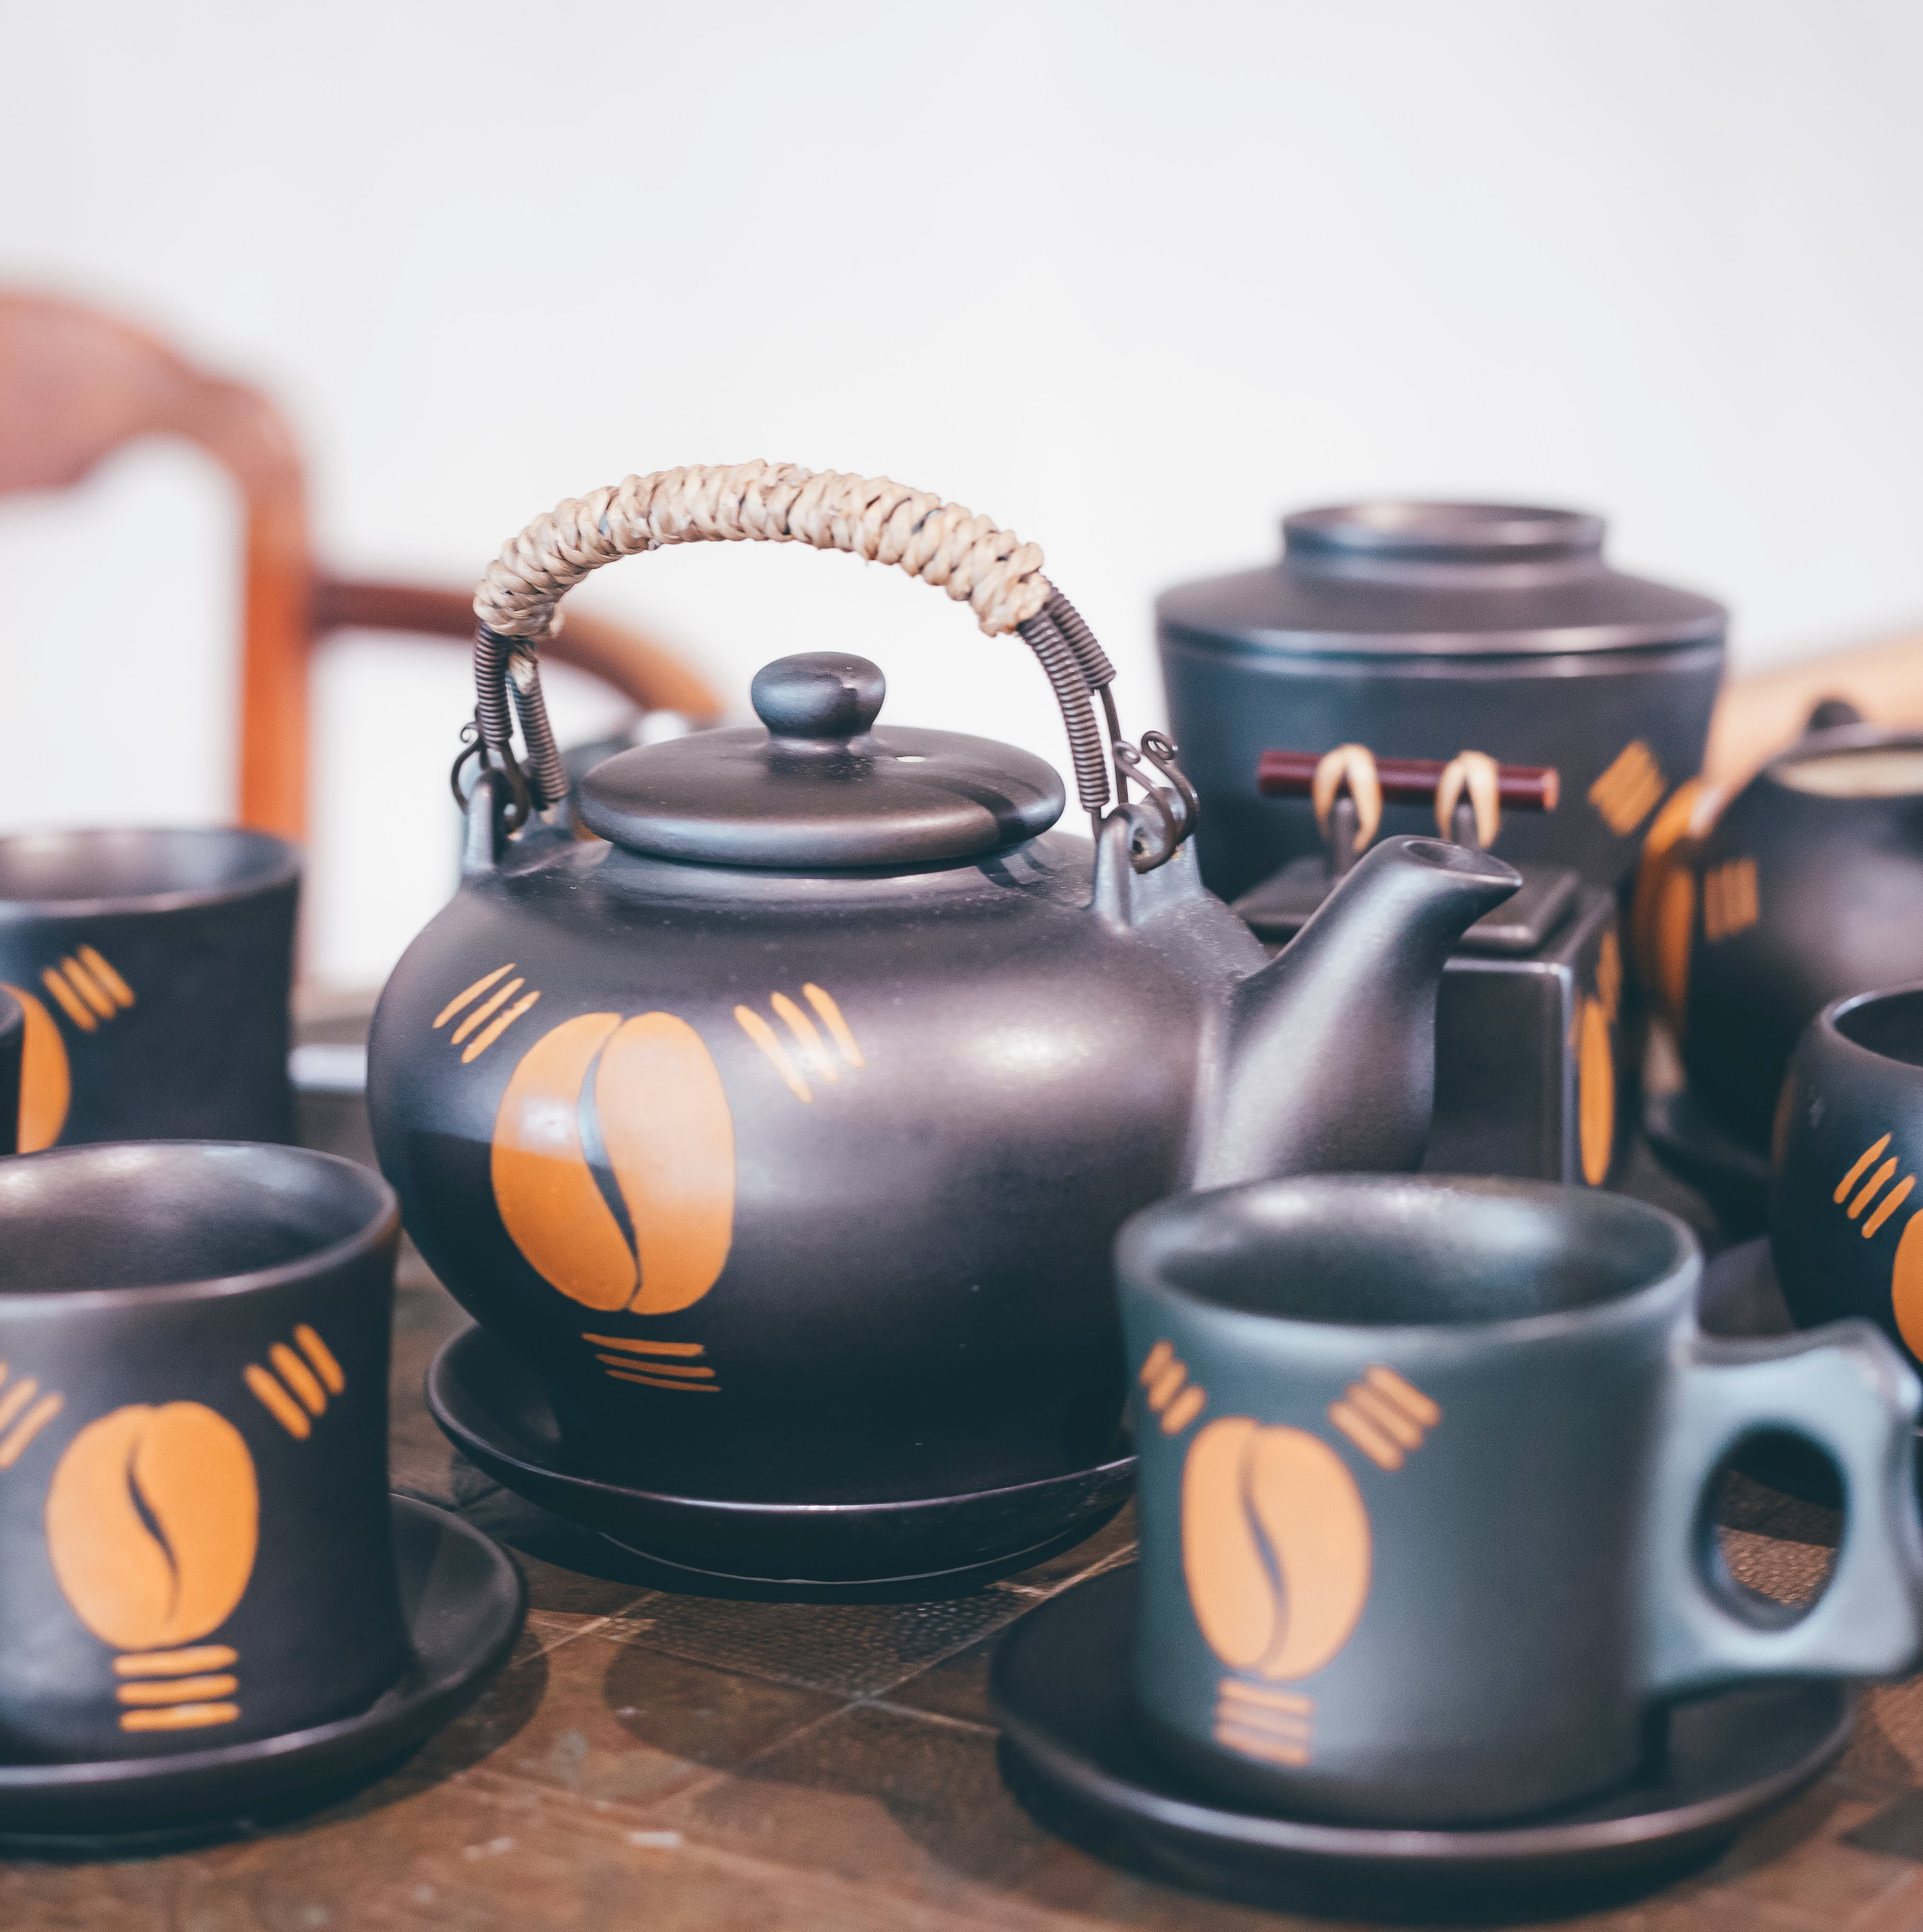
Arts
Experience the creations of the local talents.

Slide 10
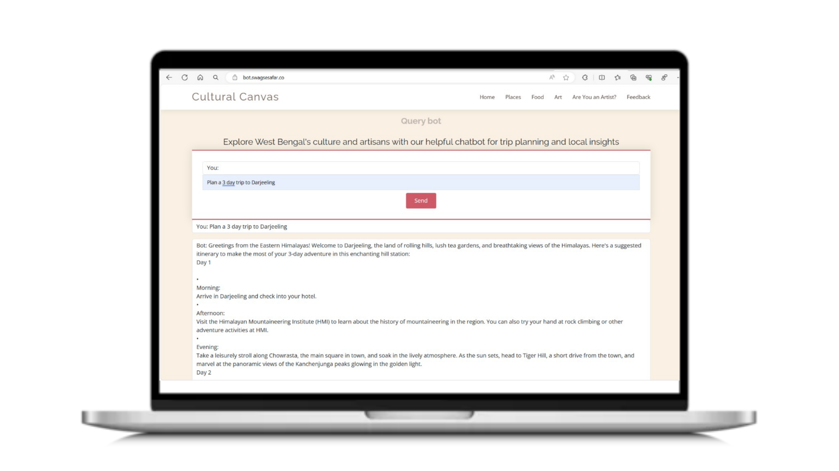
Query Bot :
Quick solution to every travel problems.
2

Slide 11
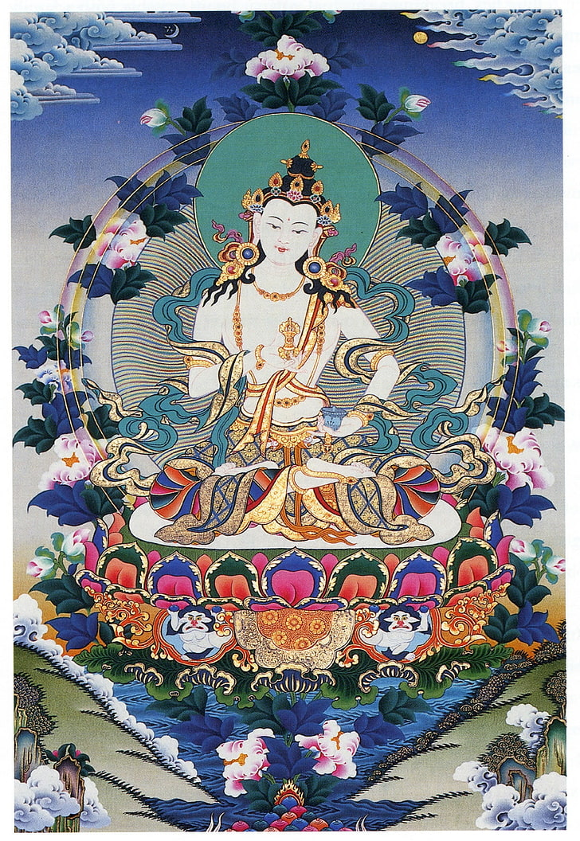


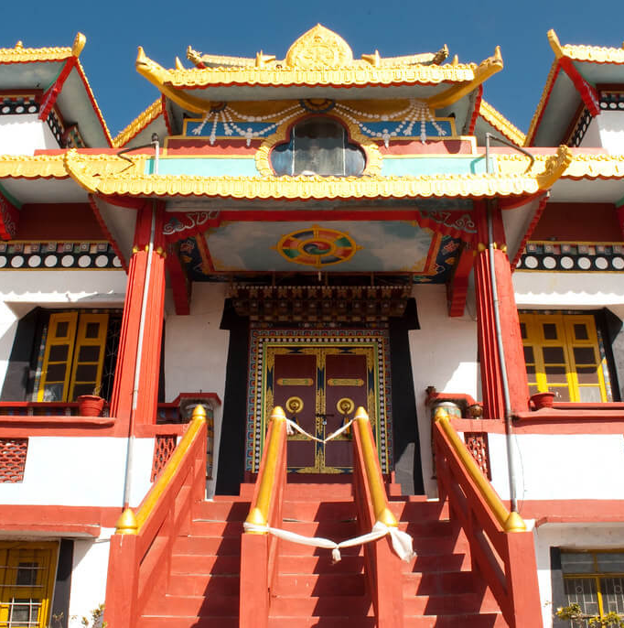
Thanks
www.swagsesafar.co
Presented By :
Team- Binary Builders

